Slide 1

AUTO-FILLER
FORM AUTO-COMPLETION USING OCR
Mentor: Wajid Bin Aqeel

Slide 2
Group Members
S M Bilal Arshad
Muhammad Mustafa Bawany
Muhammad Yaseen Amir
Ibad Saleem

Slide 3
Progress
Pre-processing of images using OpenCV
Text extraction from images using different types of OCR

Slide 4
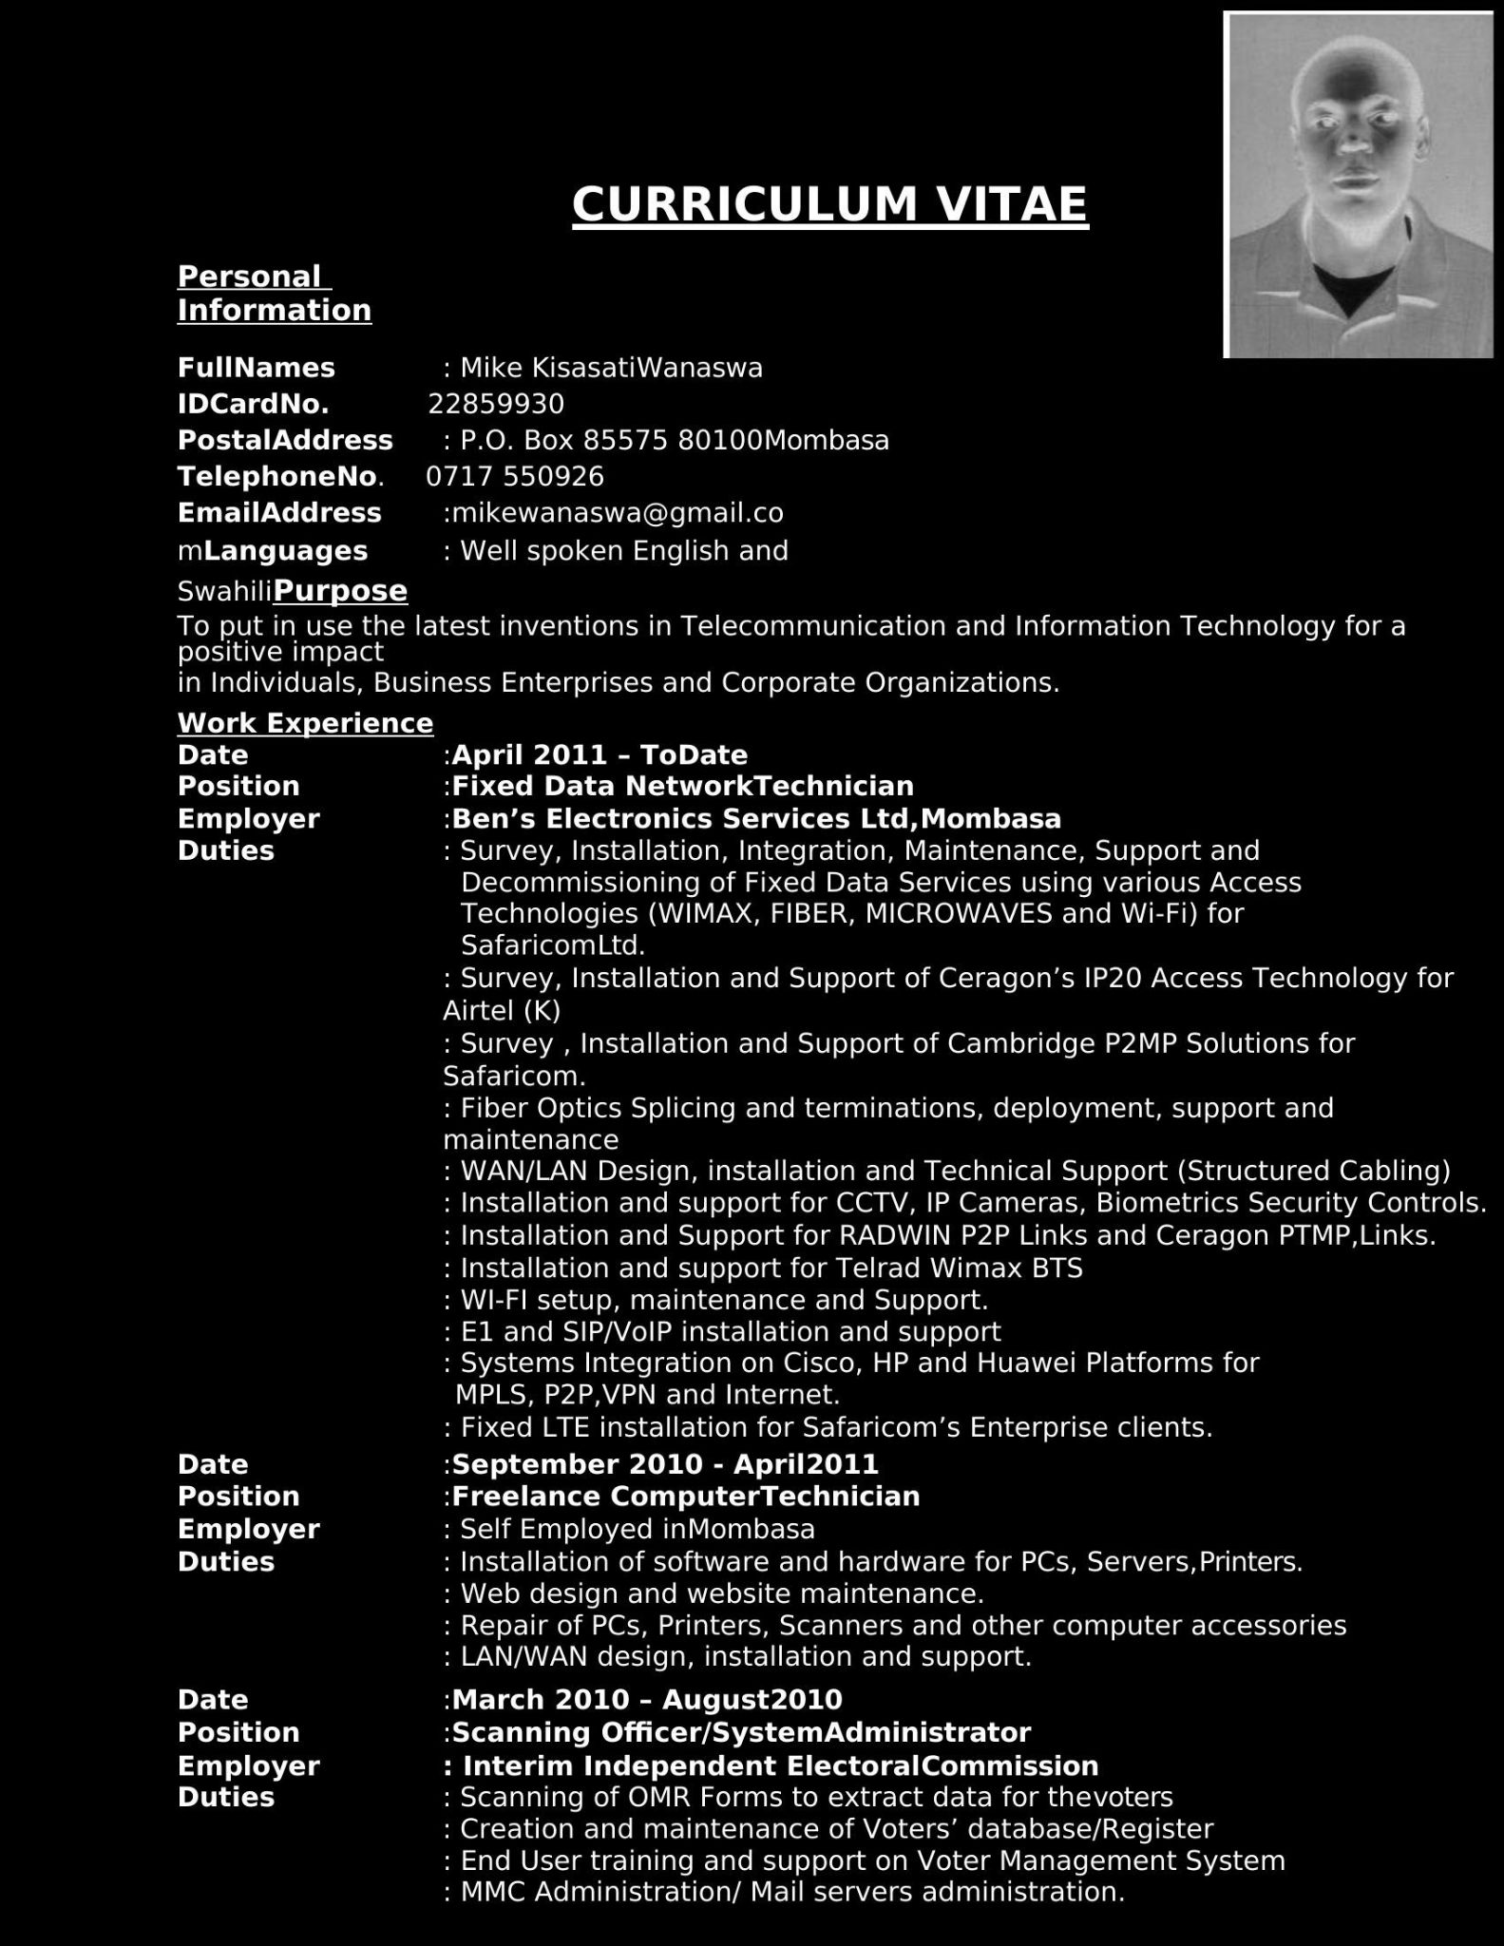
Pre-Processing

Slide 5
Types of OCR used
PyTesseract
EasyOCR
KerasOCR

Slide 6
PyTesseract
Pros
Easy to use
Fast Detection
Support 100+ Language
Oldest OCR Library
Command-line support
Cons
Only works on CPU
Doesn’t perform well on Blur, Noisy and colorful image
Performance decrease for lower font size in low-resolution images
Doesn’t work well on complex Forms

Slide 7
EasyOCR
Pros
EasyOCR supports the GPU version and performance is good on GPU.
EasyOCR provides the confidence of the extracted text which can be used to analyze further.
EasyOCR works better with noisy images when compared with tesseract.
Cons
Issue while detecting few fonts and handwritten text
Not work well on Very Low-Quality Images
Text Extraction Accuracy decreases with lower Font Size

Slide 8
KerasOCR
Pros
Pre-trained Models
If text is inside the image and their fonts and colors are unorganized, Keras-ocr gives good results
Cons
Need to convert documents into images for preprocessing
Need images for retrieving data
Fetches Noise from the document require noise clearing from the document

Slide 9
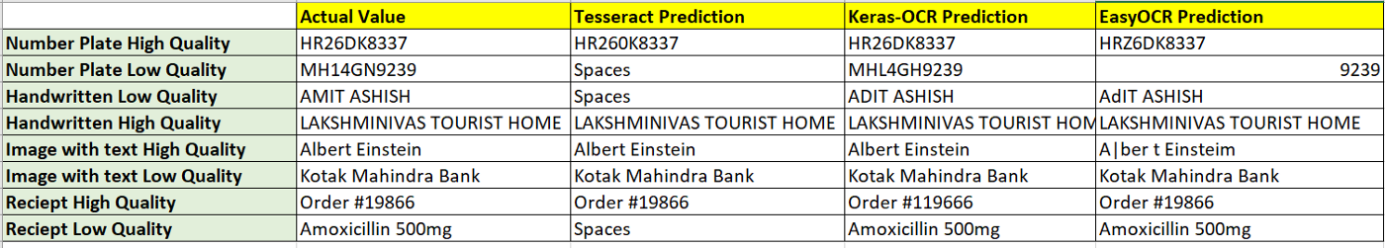
Comparing OCRs

Slide 10
Shortlisted OCR
PyTesseract is performing well for high-resolution images.
Certain morphological operations such as dilation, erosion, binarization have helped us in increasing pytesseract performance.

Slide 12
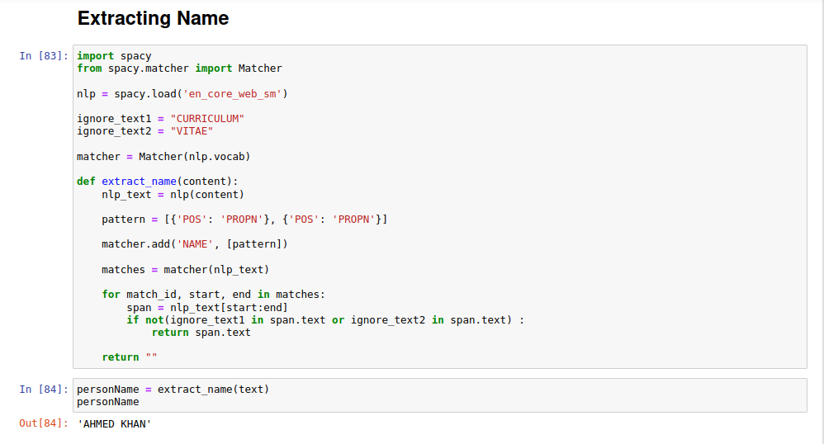
Text Extraction

Slide 13
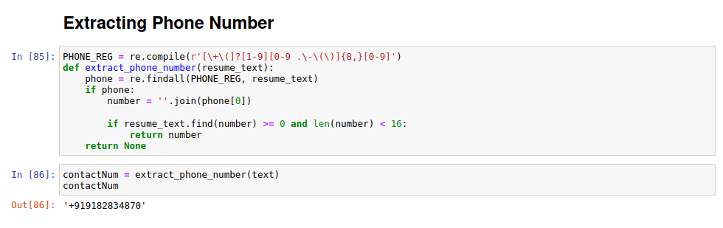
Text Extraction

Slide 14
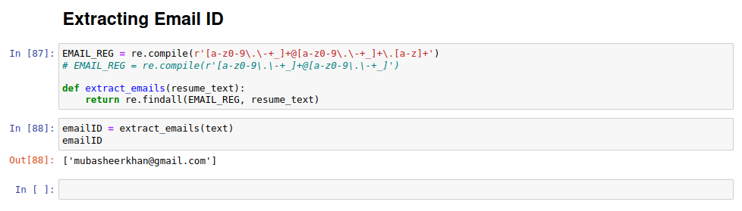
Text Extraction

